Slide 1



Minor Project Report - I
1th Review Presentation

Slide 2
Team Members
01
02
03
Deepika Merlin N
Team Leader
Varshini S
Jayanthan S

Slide 3
Table of Content
01
02
03
Intruduction
Abstract
Features
04
Conclusion

Slide 4



01
Introduction
An Overview of Our Project

Slide 5
Introduction
For our proposal, we have already conducted a study.Themajority of respondents said they would like to see our idea implemented in daily life.
In their uncharted territories, it assists them to obtain a
freight shipping vehicle.
More money may be made by shipping goods by putting this concept into practice in both urban and rural areas.

Slide 6




100+
We collected these much response through this Survey

Slide 7
85% of people welcomed our project

Slide 8
02
Abstract
An Overview of our Project

Slide 9
Mercury
Jupiter
It’s the closest planet to the Sun
Jupiter is the biggest planet of them all
Venus
Saturn
Venus has a beautiful name and it’s hot
Saturn is a gas giant with many rings

Slide 10
What sets us apart?

Slide 11

Features
03
Facilities given by ourself

Slide 12
Our Service
All kind of frights transportation
Bulg Transportation
Railways
Waterways
100+
25+
75+
90+
Roadways
Airways
All Kind of facility available
Light weight goods alone

Slide 13
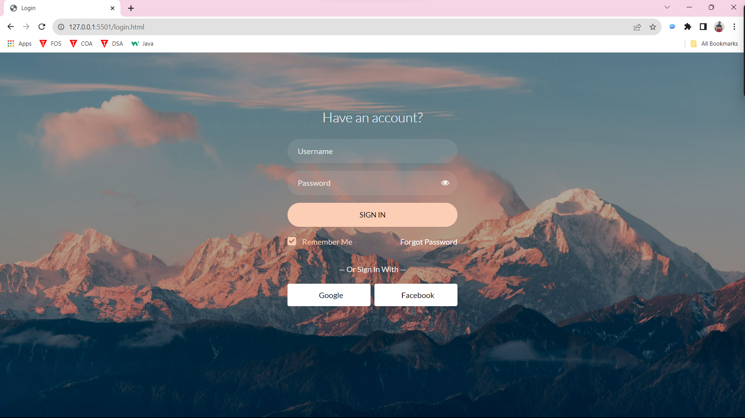
Login Page

Slide 14
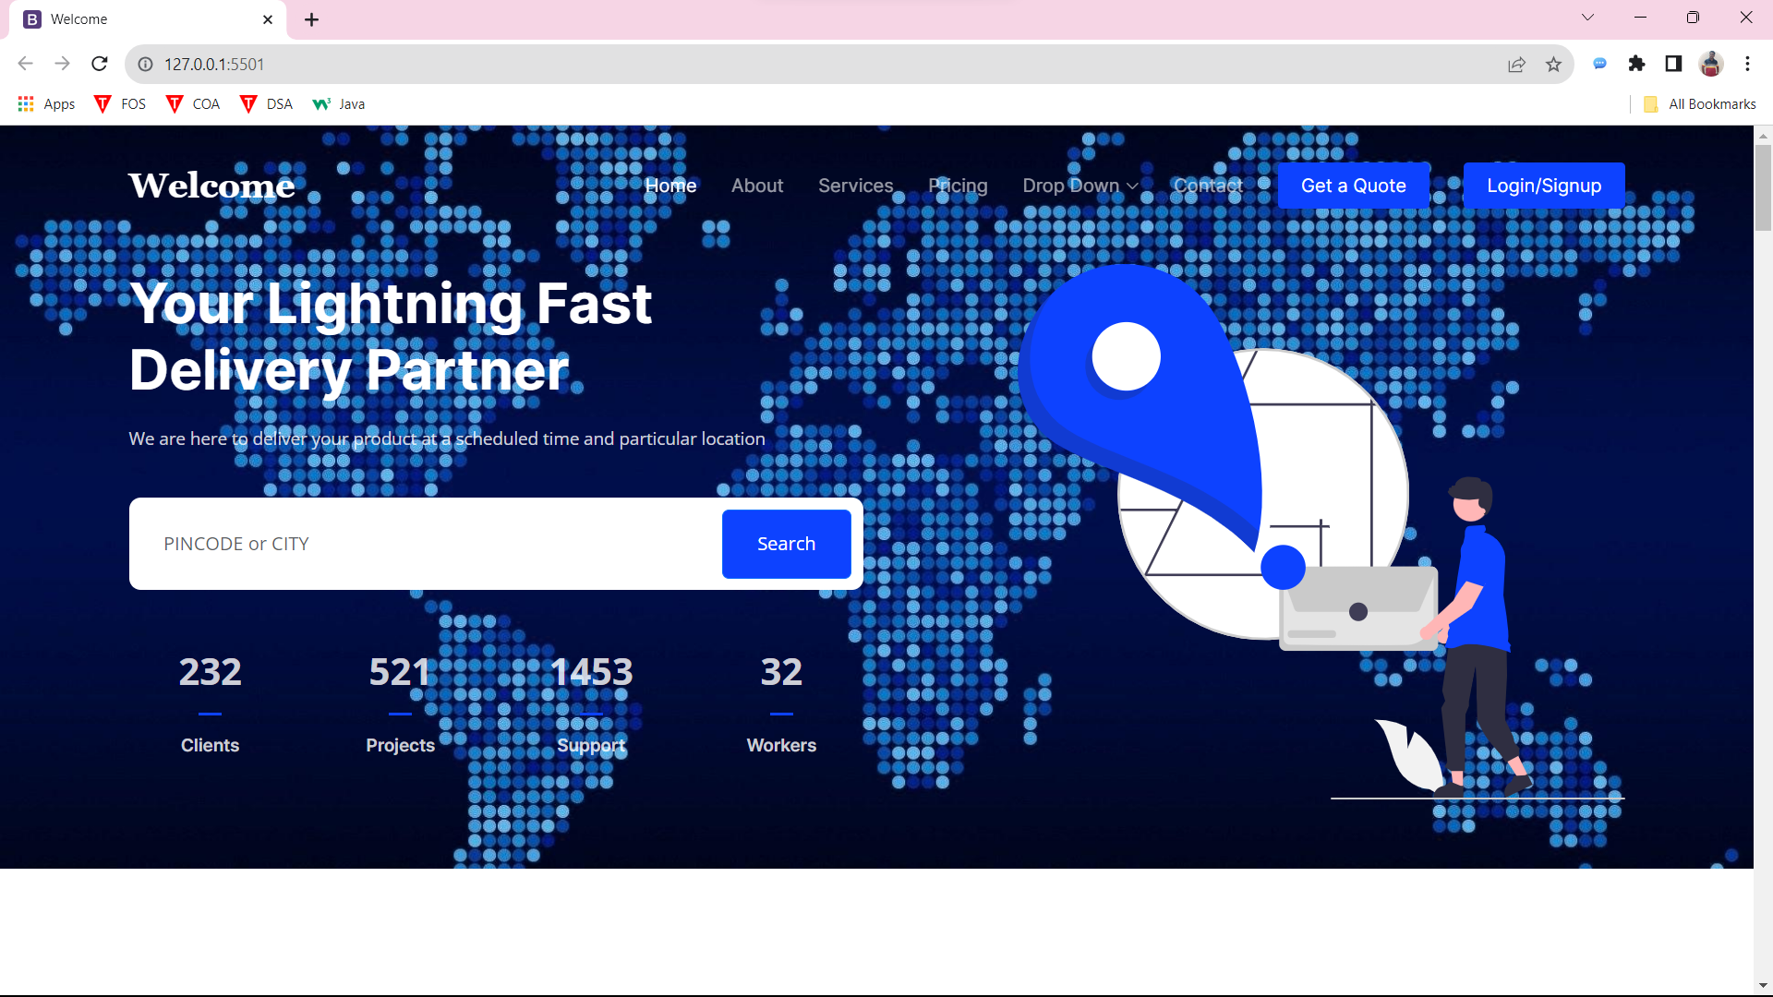
Official Page

Slide 15
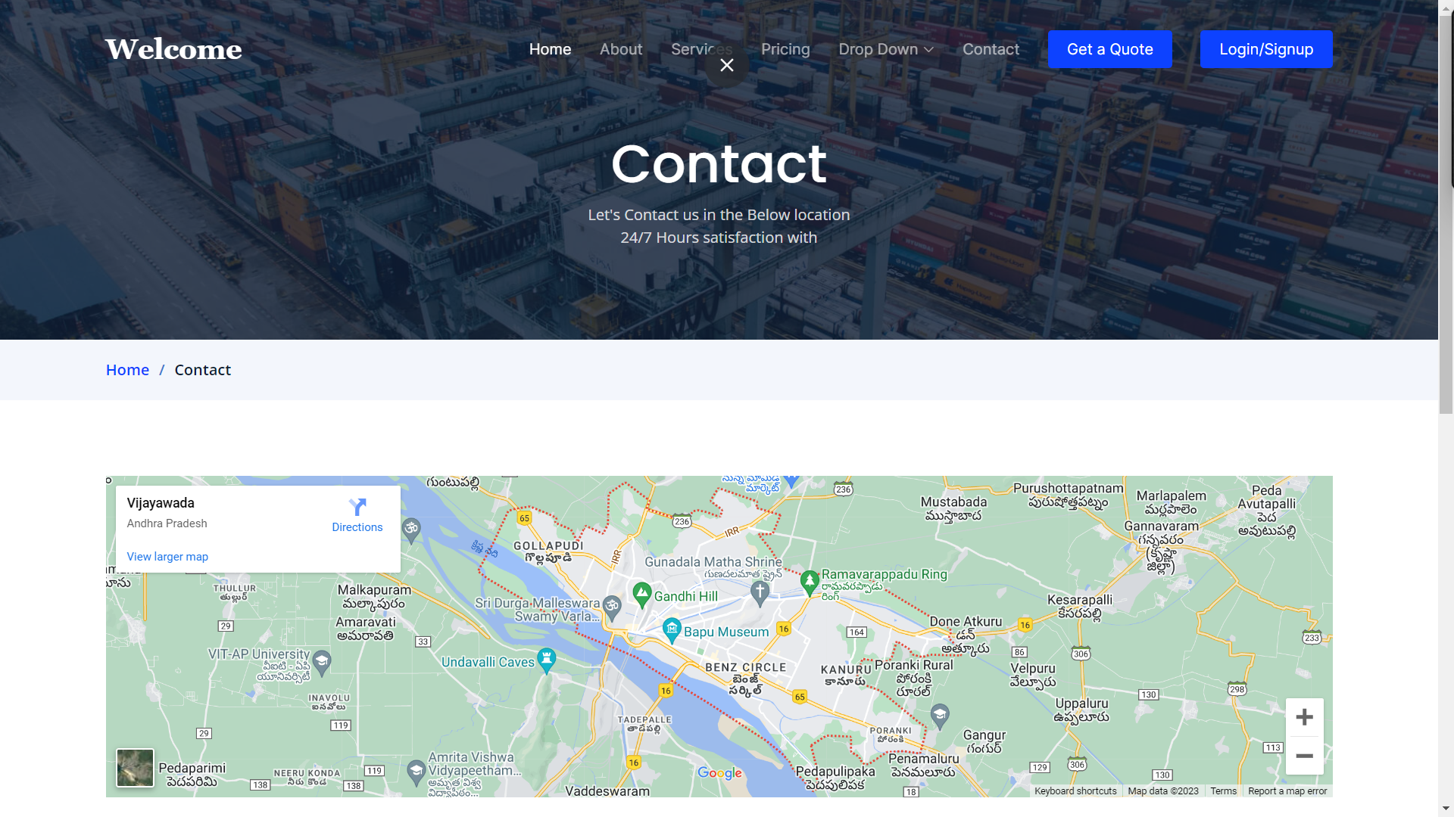
Contact Page

Slide 16
How do we do it?
Neptune
Jupiter
Despite being red, Mars is actually a cold place
Jupiter is the biggest planet in the Solar System
Mars
Saturn
Neptune is the farthest planet from the Sun
Saturn is a gas giant and has several rings

Slide 17
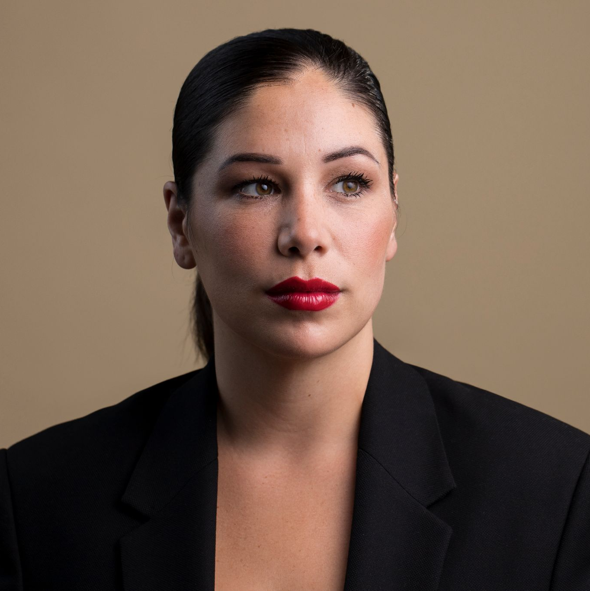

175
333,000
386,000 $
Members of our association
People helping us to collaborate
Money raised in one year

Slide 18

What do we offer?
30%
20%
Mars
Mercury
Mars is actually a very cold place
Mercury is a very small planet
25%
25%
Venus
Jupiter
Venus has a beautiful name
Jupiter is a very big planet
Follow the link in the graph to modify its data and then paste the new one here. For more info, click here

Slide 19
—Someone Famous
“This is a quote, words full of wisdom that someone important said and can make the reader get inspired.”

Slide 20
This is a map
Venus
Venus is the second planet from the Sun
Mercury
Mercury is the closest planet to the Sun
Saturn
Saturn is a gas giant and has several rings

Slide 21
Awesome words

Slide 22
Our clients
Venus
Mars
Saturn
Venus is the second planet from the Sun
Mars is actually a very cold place
Saturn is composed of hydrogen and helium
Mercury
Jupiter
Neptune
Mercury is the closest planet to the Sun
Jupiter is the biggest planet of them all
Neptune is the farthest planet from the Sun

Slide 23
What do they say about us?
“Neptune is the farthest planet from the Sun and the fourth-largest one in the Solar System”
—Laura Patterson
“Mercury is the closest planet to the Sun and also the smallest one in the Solar System”
—Monique Nelson
“Despite being red, Mars is a cold place. It’s full of iron oxide dust, which gives the planet its reddish cast”
—John James

Slide 24

Computer mockup
You can replace the image on the screen with your own work. Just right-click on it and select “Replace image”

Slide 25
Case studies
Area | Jupiter | Venus | Mars
Work 1 | Mars is cold | Mars is made of basalt | Mars is a red planet
Work 2 | Mercury is small | Earth has life | We all live on Earth
Work 3 | Venus is hot | Jupiter is a gas giant | Venus is hot
Work 4 | Saturn is a gas giant | Saturn has rings | Neptune is an ice giant
Work 5 | Venus is hot | Mars is made of basalt | Mercury is small

Slide 26

A picture is worth a thousand words

Slide 27

A picture always reinforces
the concept
Images reveal large amounts of data, so remember: use an image instead of a long text. Your audience will appreciate it

Slide 28
Awards
2XXX - 2XXX
2XXX- 2XXX
Name of the award (Organization)
Name of the award (Organization)
Name of the award (Organization)
Name of the award (Organization)
Name of the award (Organization)
Name of the award (Organization)
Name of the award (Organization)
Name of the award (Organization)

Slide 29
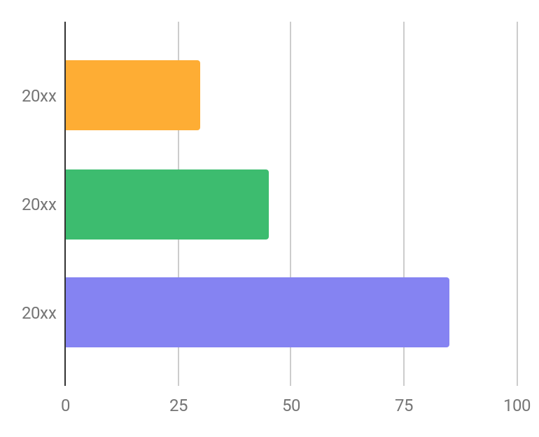
Our success
30%
Neptune
Neptune is the farthest planet from the Sun
45%
Mercury
Mercury is the smallest planet of them all
85%
Mars
Despite being red, Mars is actually a cold place
Follow the link in the graph to modify its data and then paste the new one here. For more info, click here

Slide 30

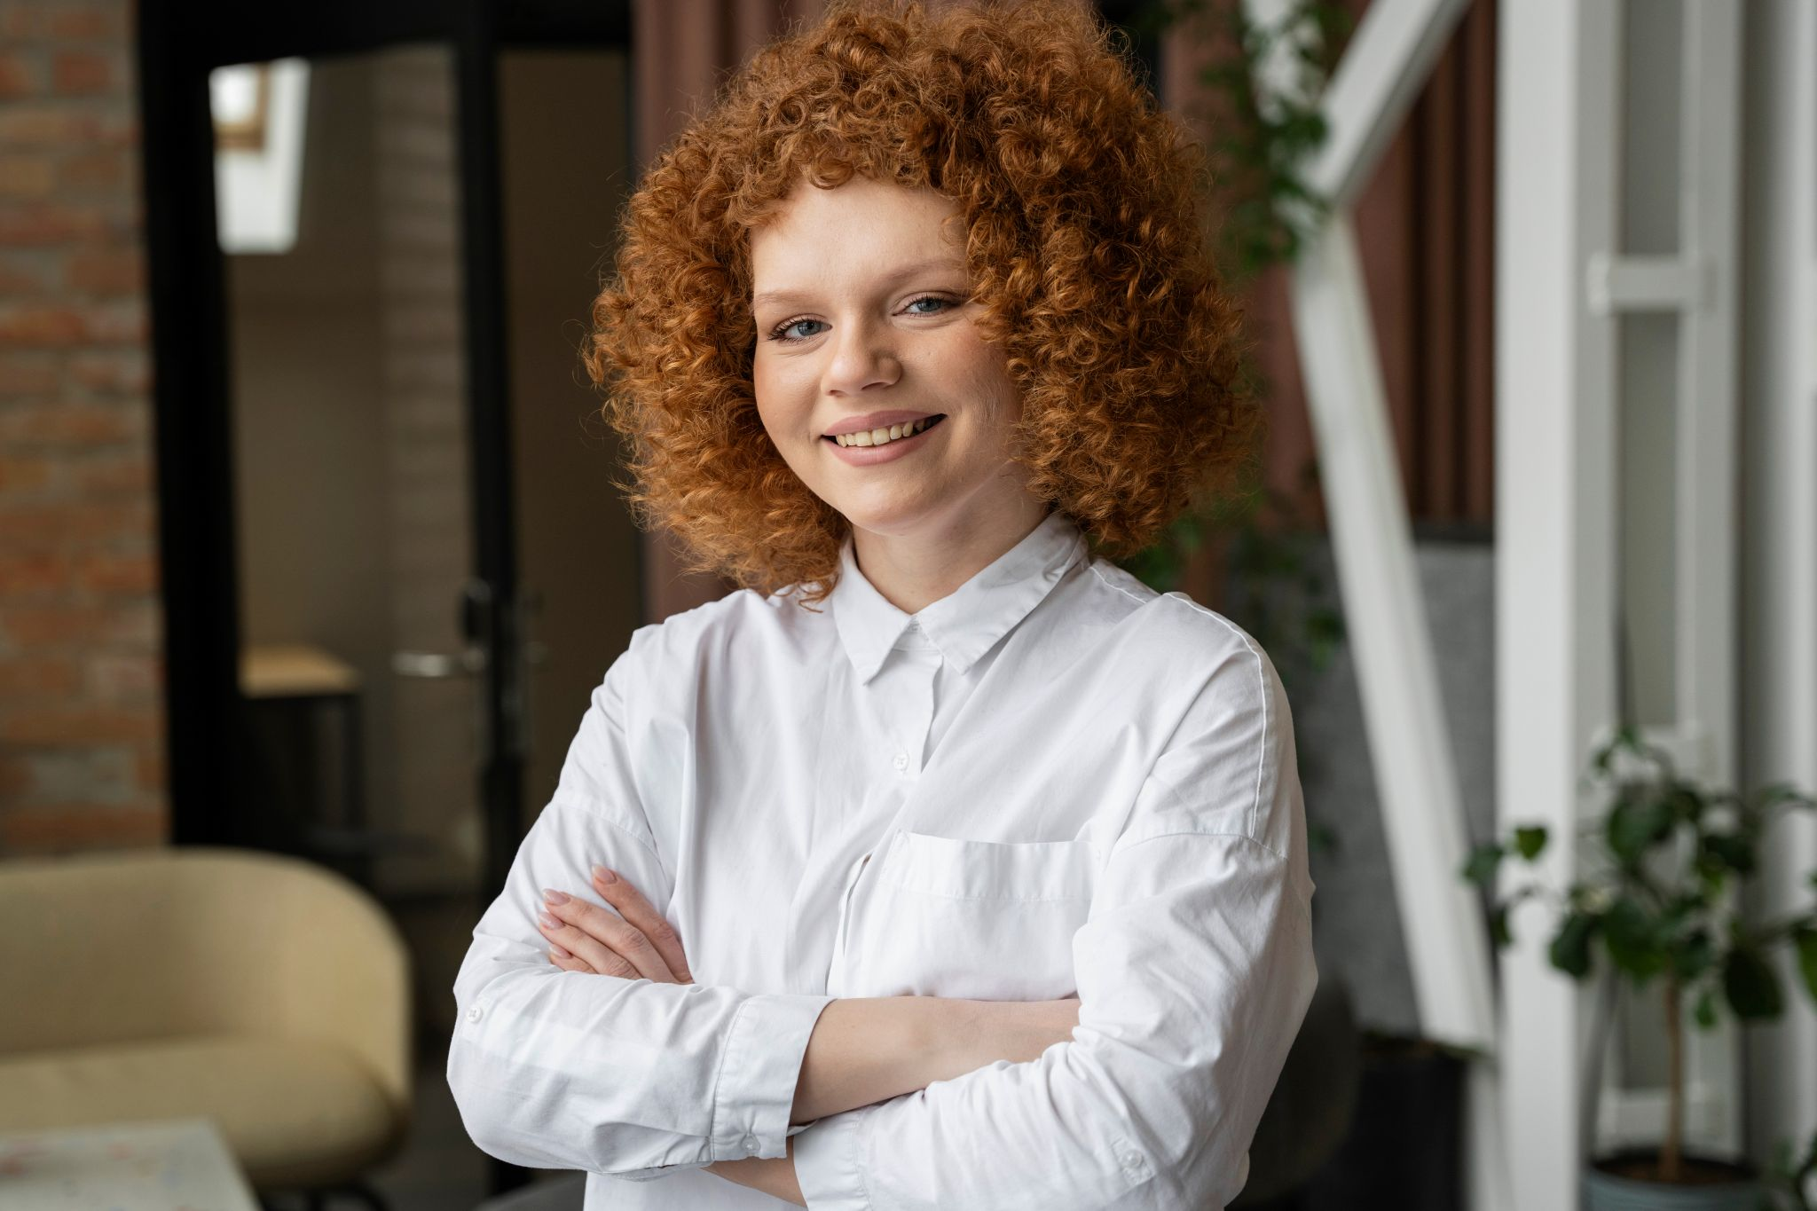
Meet the team
John Doe
Helena James
You can replace the image on the screen with your own
You can replace the image on the screen with your own

Slide 31
Thank You.

